Slide 1


Air Pollution effects
Kevin Nguyen | Tasha Kim

Slide 2
Background
According to the World Health Organization (WHO), our pollution is linked to 7 million premature deaths around the world.
Most of these diseases caused by air pollution are related to the heart and lungs.
In this project, we want to explore how air pollution levels are related to deaths, and how air pollution-related deaths compare in the US vs. around the world.

Slide 3
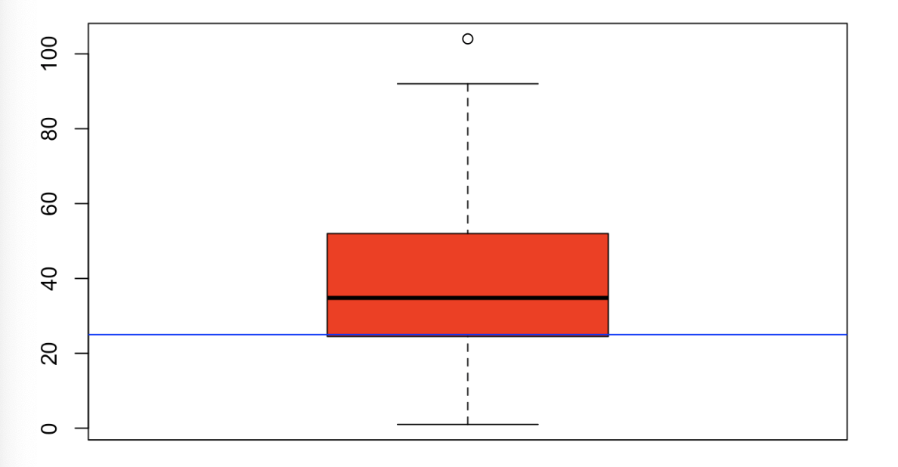
Exploratory Data Analysis (EDA)
Fact: According to the International Journal of Public Health, 57 countries in the world did not set any air quality standards.
Ambient air quality standards for PM2.5 and PM10 poorly complied with WHO guideline values.

Slide 4
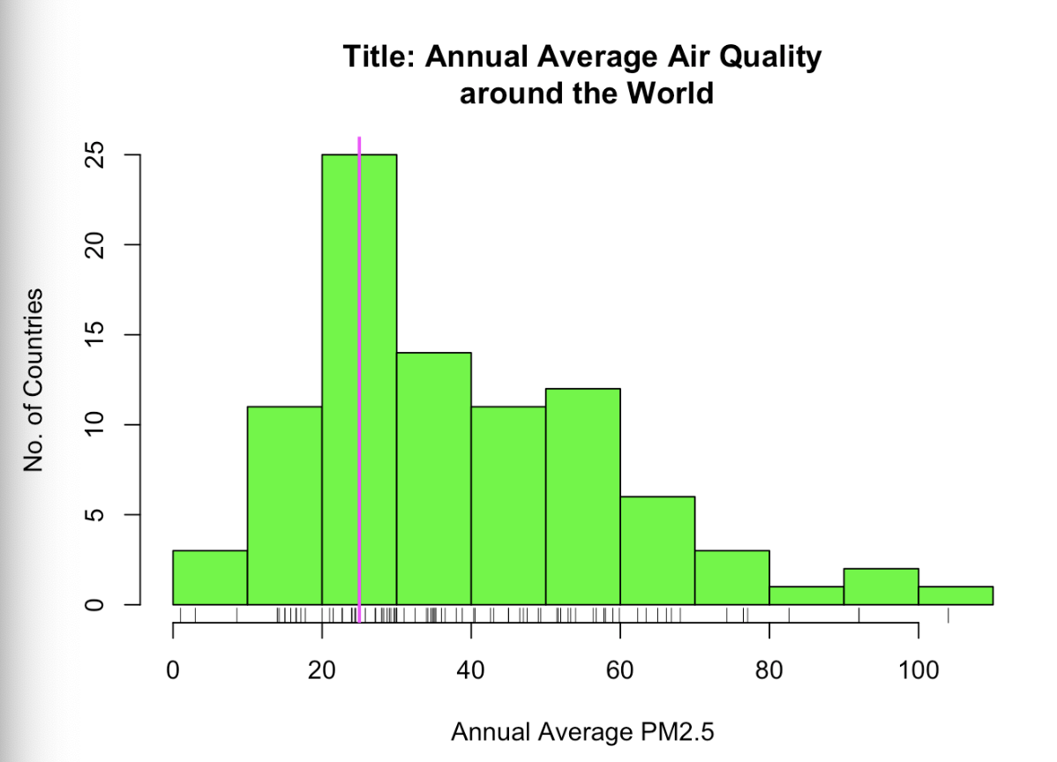
65 countries failed to meet WHO’s Global annual mean Interim Target (IT) 2 value(73%).
86 countries failed to meet WHO’s Global annual mean value guidance (97%).
-out of 89 countries measured

Slide 5

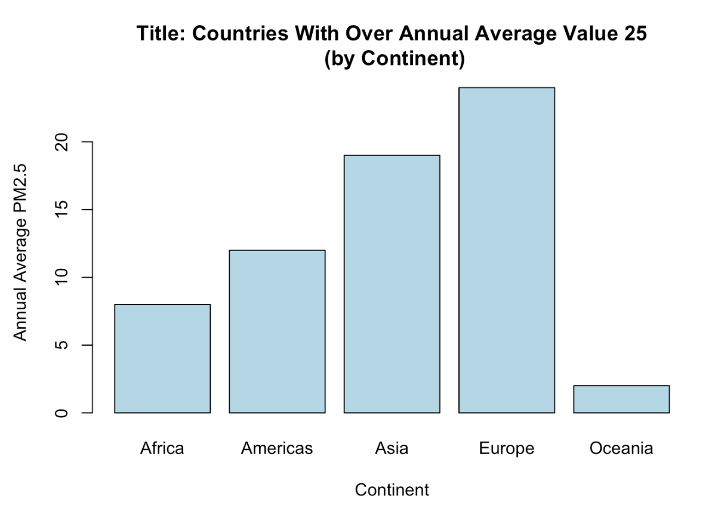
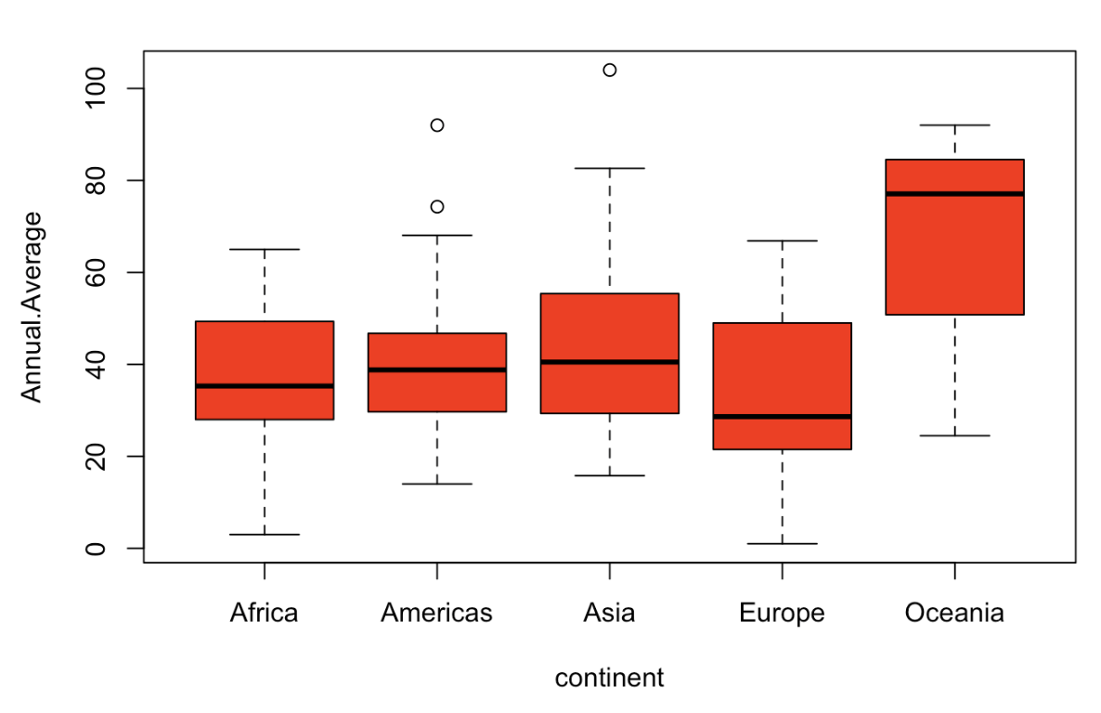
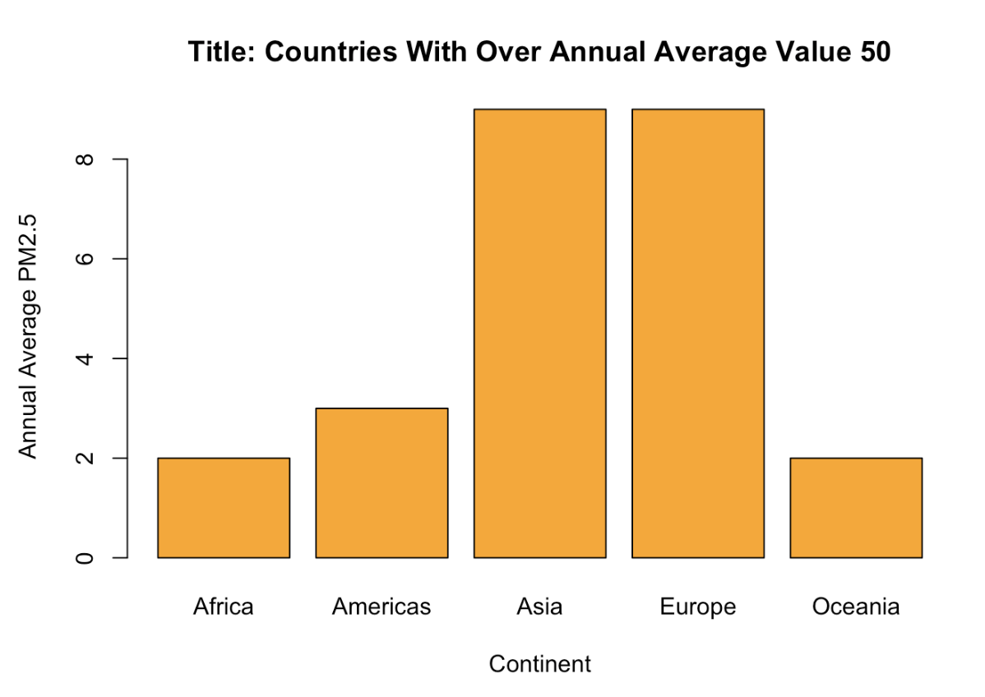
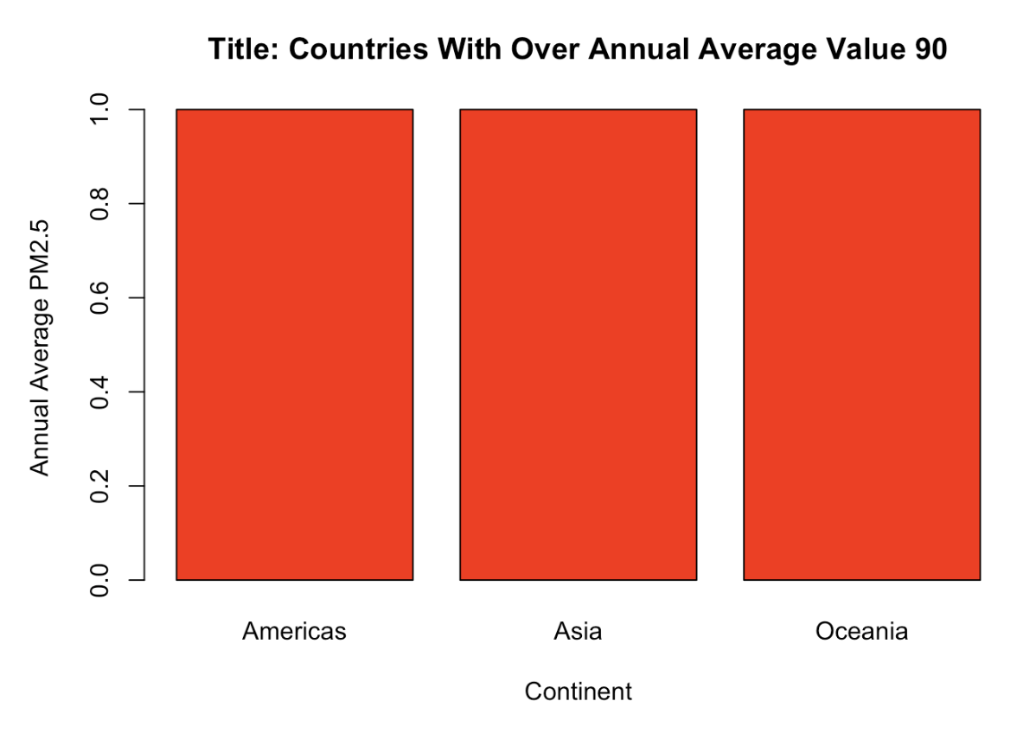
Annual Average Ambient Air Quality, by Continent

Slide 6
Hypothesis 1: Hypothesis Testing
Hypothesis 1: There is a direct correlation between average life expectancy and air pollution around the world.
In order to test this hypothesis, we choose to use a type of supervising learning used to model a relationship among numerical variables where it is hypothesized that one depends on the others: Regression.
Predictor: air quality, measured as PM2.5 micrograms per cubic meter,
Response variable : life expectancy by country.

Slide 7
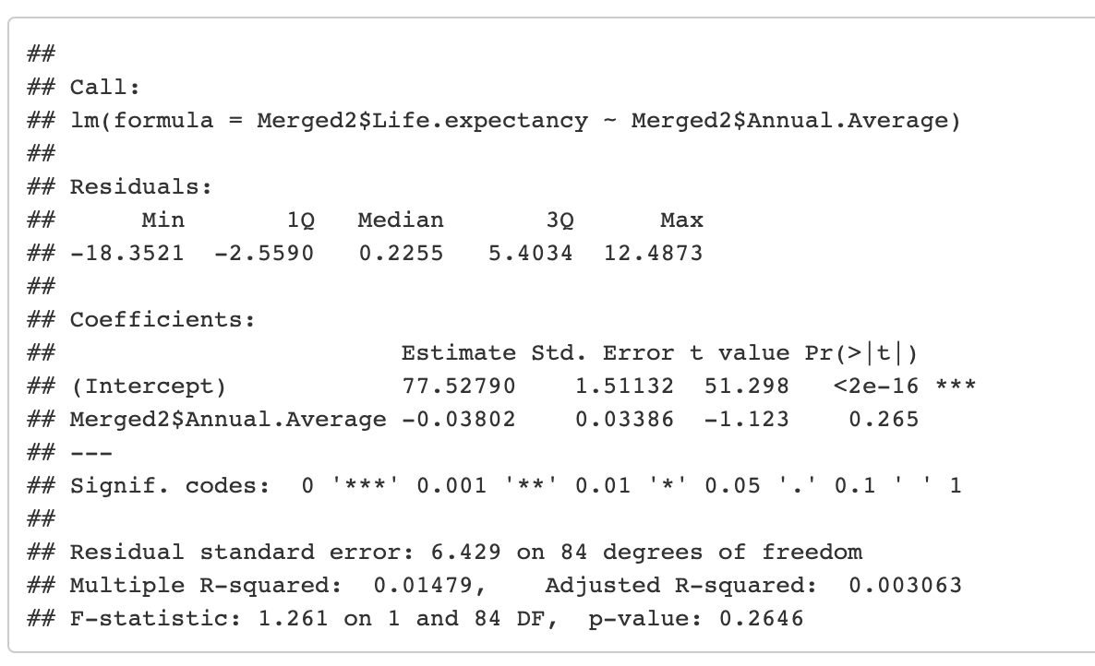
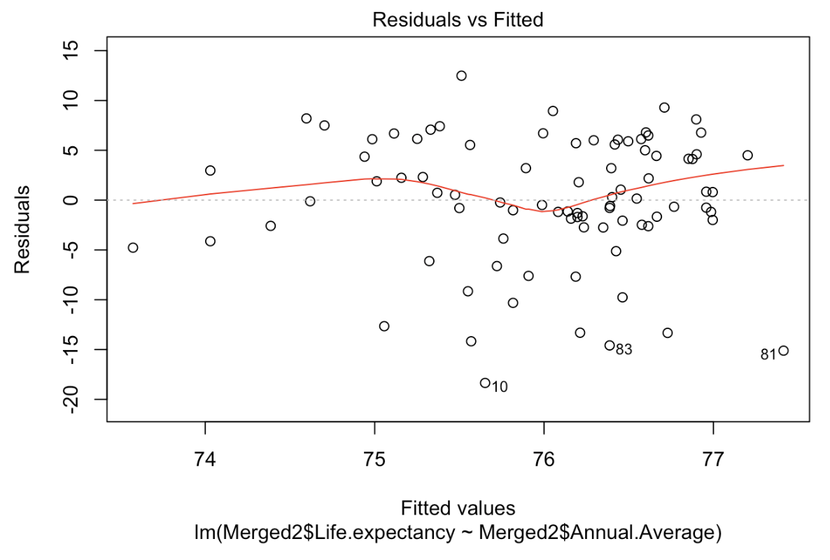
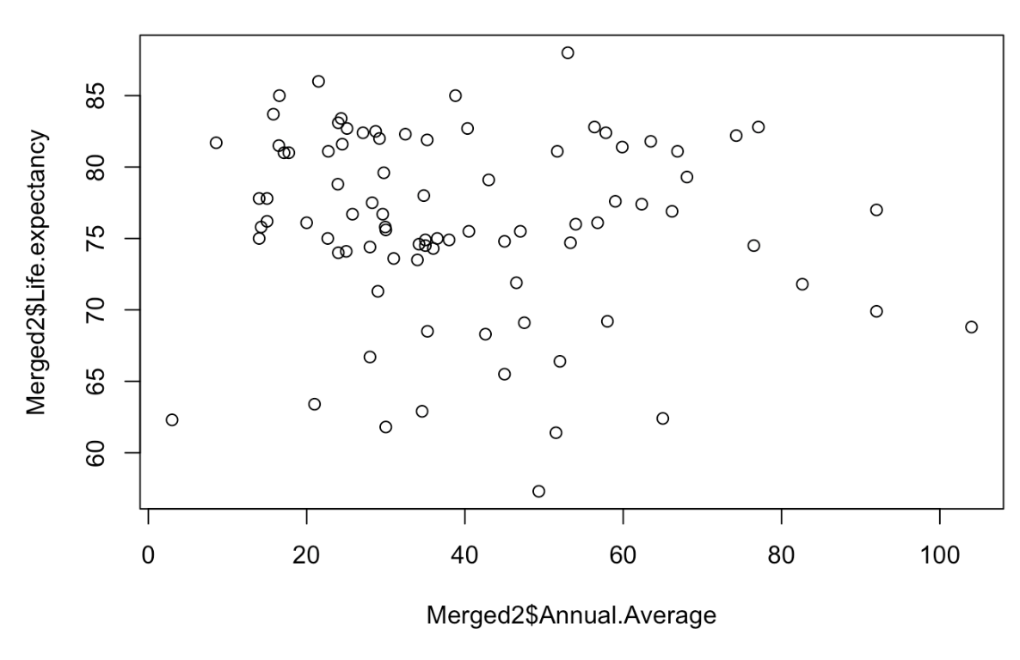
Model: Linear Regression Model
There seems to be no strong correlation between average life expectancy of a country and the average air quality. The negative correlation shows that there may be a slight indirect relation between long life expectancy and high air pollution.
Running linear regression, and add a line to best fit our scatterplot using the abline command.
Looking at our summary table, we find that the p-value for the y-intercept is not less than 0.05. Therefore, we conclude that this predictor is not significant. We also have a very low R^2 value, so there are much more significant factors besides air quality that affect a person’s life expectancy.
Conclusion: From the linear regression model, we conclude that air pollution levels is not a good predictor of life expectancy across the world.

Slide 8
Hypothesis 2: Air pollution increases the rate at which people die from common lung diseases.
To test this, we compared the concentration of fine particulate matter to the rate at which people die of tuberculosis, a lung disease that the risk of contracting it increases from direct smoking.
Predictor: air quality, measured as PM2.5 micrograms per cubic meter,
Response variable : Deaths due to tuberculosis, measured as per 100,000 people

Slide 9
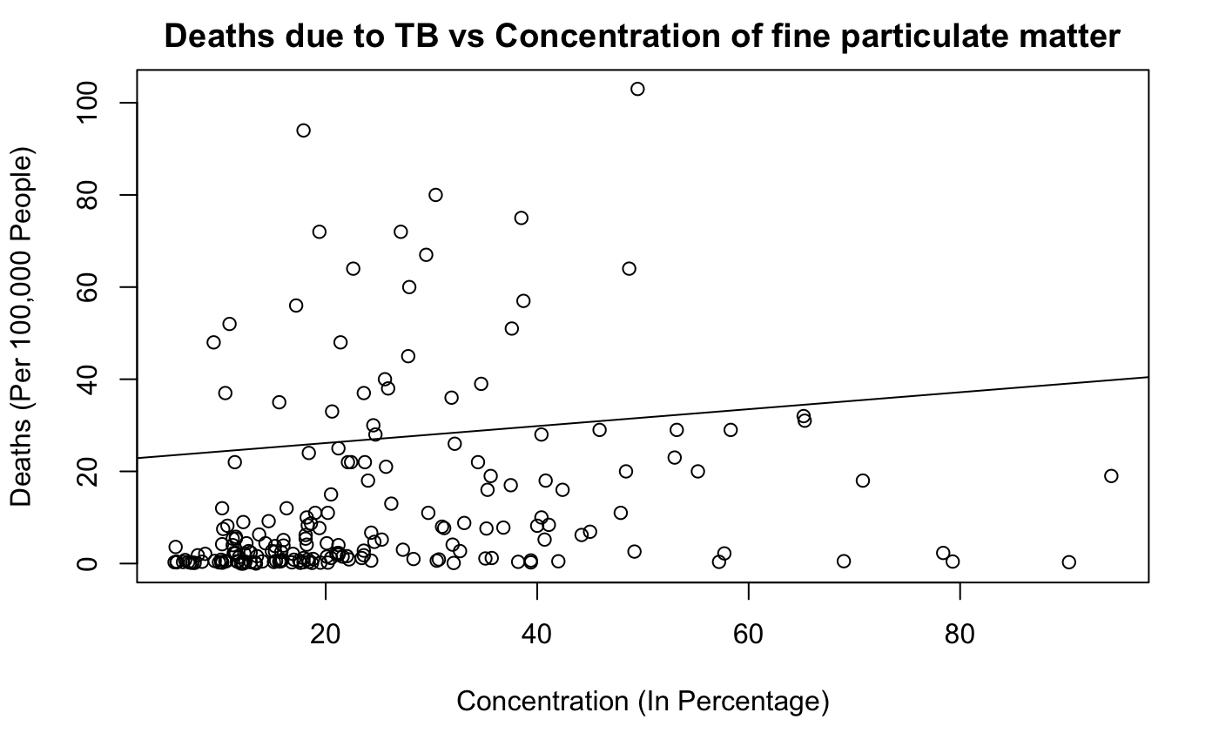
Model: Linear Regression Model
The abline shows that there is a slight correlation between the two values
Residuals:
Min 1Q Median 3Q Max
-21.903 -10.463 -4.768 6.724 68.328
Coefficients:
Estimate Std. Error t value Pr(>|t|)
(Intercept) 22.47954 1.37523 16.346 < 2e-16 ***
Deaths.per.100k.due.to.Tuberculosus 0.18382 0.05884 3.124 0.00206 **
---
Signif. codes: 0 ‘***’ 0.001 ‘**’ 0.01 ‘*’ 0.05 ‘.’ 0.1 ‘ ’ 1
Residual standard error: 16 on 192 degrees of freedom
Multiple R-squared: 0.04838, Adjusted R-squared: 0.04342
F-statistic: 9.76 on 1 and 192 DF, p-value: 0.00205
Due to the p-value being low at .002, there is a significance in the concentration of fine particulate matter on deaths from tuberculosis.
Conclusion: From the linear regression model, we conclude that air pollution levels is a good predictor of deaths caused by TB, but cannot be accurately used to predict the amount of deaths

Slide 10
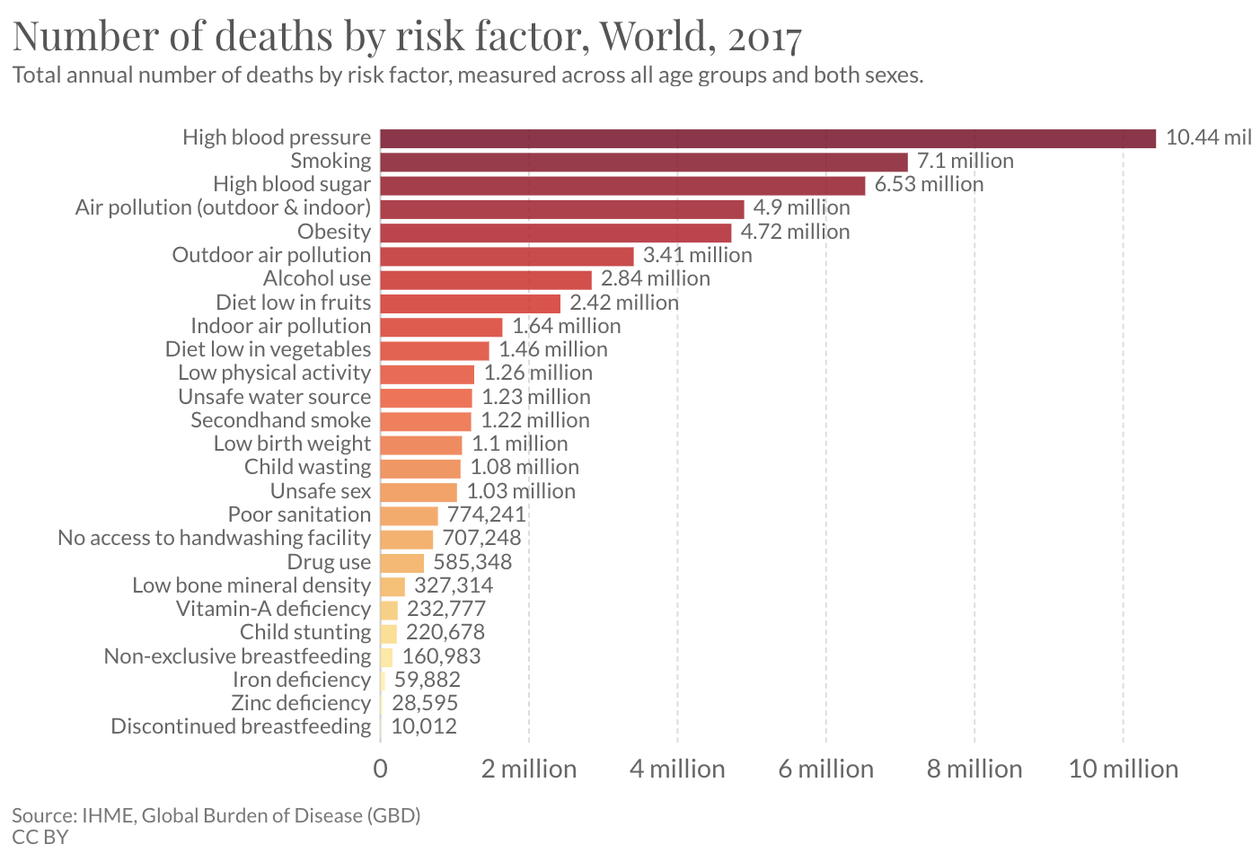

Slide 11


Hypothesis 3: Hypothesis Testing
Hypothesis 3: Americans have more air-pollution related deaths compared to the rest of the world.
One-sided difference of sample proportions test:
Confidence interval of 95%:
Confidence interval did not contain 0.. Conclusion: the difference is significant enough to note.
Difference in Sample Proportions Significance Test:
(1) NULL HYPOTHESIS: The proportion of people that who die in Americas from air pollution is greater than the proportion of people that die in the World from air pollution. i.e., PH > PT
(2) ALTERNATE HYPOTHESIS: The proportion of people that who die in Americas from air pollution is less than the proportion of people that die in the World from air pollution. i.e. PH < PT
Result: p-value: <<0.05m, so NULL HYPOTHESIS rejected

Slide 12
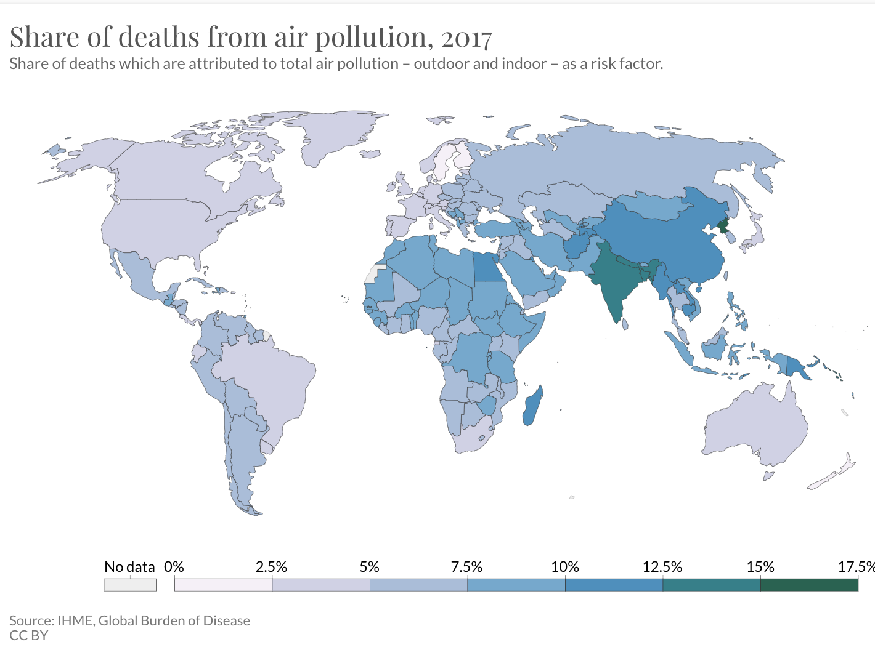

Slide 13
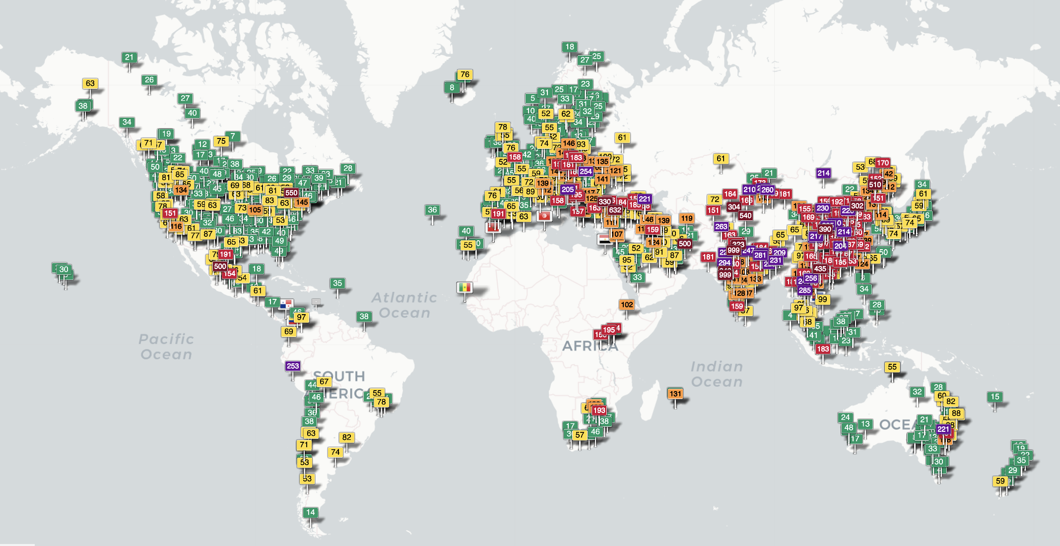
Classification: K-NN Classification
We want to cluster regions of the world by air pollution levels.
Evaluating Accuracy of Model: The accuracies are all below 0.5. A k-value of 3 (k=3) gives the best accuracy, which is just over 30%. This low accuracy shows that k-NN classification is not a very effective way to classify regions of the world.
Hence we chose not to use a k-NN model, but turn to a different ML algorithm, the K-means clustering.

Slide 14
Closing Thoughts
We have analyzed our data by testing various hypotheses that we came up with from initial speculations of our given dataset. We wanted to think about what may not have been depicted in our dataset. We thought that our data on the number of air-pollution related deaths in each country may not accurately assess how much deaths are actually related to air pollution. We note that a high measured air pollution related death may not necessarily correlate with actual number, due to causation not being equal to correlation. For example, reported air pollution related deaths may not accurately depict actual air polluted related deaths happening in country because this could indicate that there are more deaths being identified as air pollution related, hence medical technology is advanced.
We think that it is important to critically assess what information can be obtained from our data, and what conclusions we can draw from it, by understanding that datasets can be incomplete or inaccurate at times.

